Slide 1
Dynatrace AI Demystified
Andreas Grabner, @grabnerandi

Slide 2
Why we built “the new” Dynatrace
OneAgent, Smartscape, Root Cause Detection
Hypercube Baselining, Anomaly Detection

Slide 3

The idea “Automatic APM” (~2012)
Next gen AI based APM solution
Detect anomalies automatically
Automatically understand dependencies
Show correlations between incidents
Automatically detect root cause (component)
Measure/predict impact
Assisted code level root cause analysis

Slide 4

Dynatrace SaaS
Dynatrace Managed
US East, US West, Ireland, Australia
Your data center

Slide 5
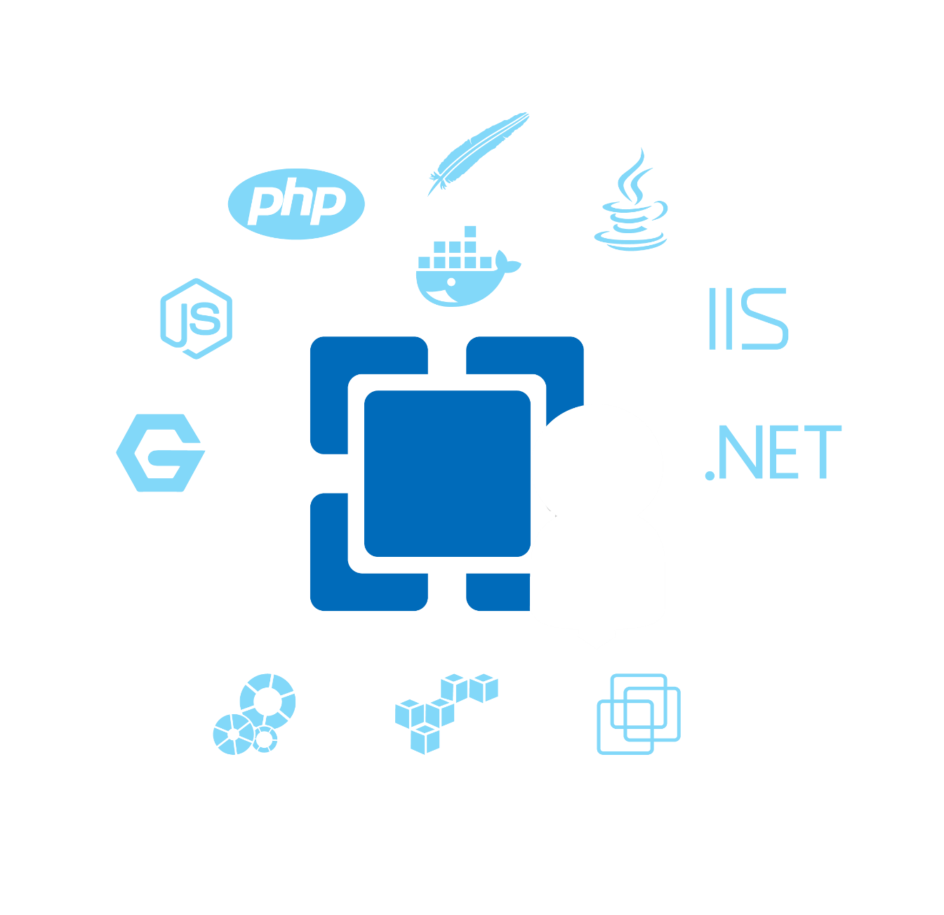
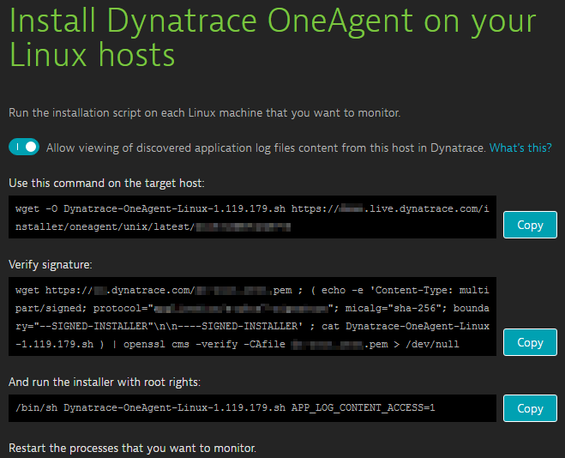
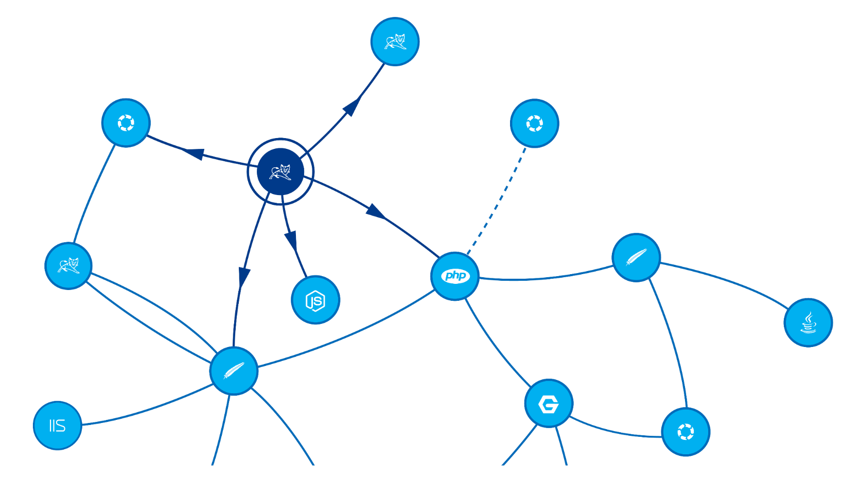

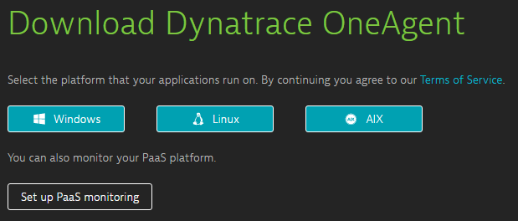




One Agent to monitor them all

Slide 6
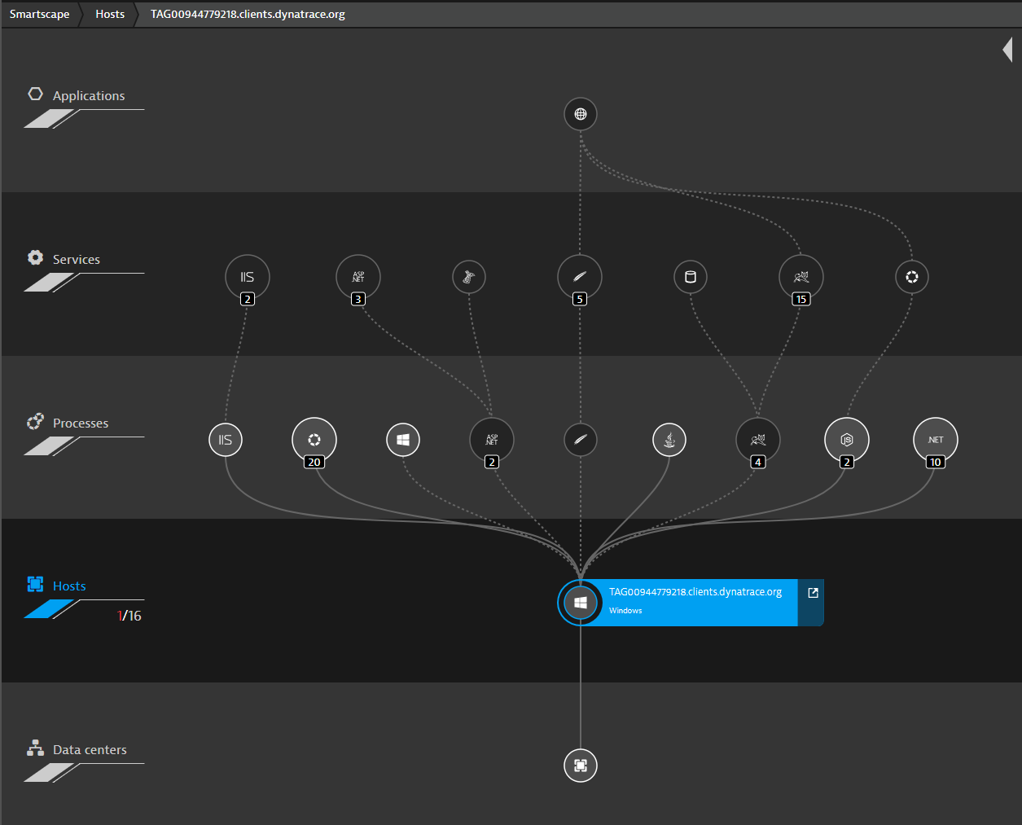
Dynatrace Full Stack Monitoring

Slide 7
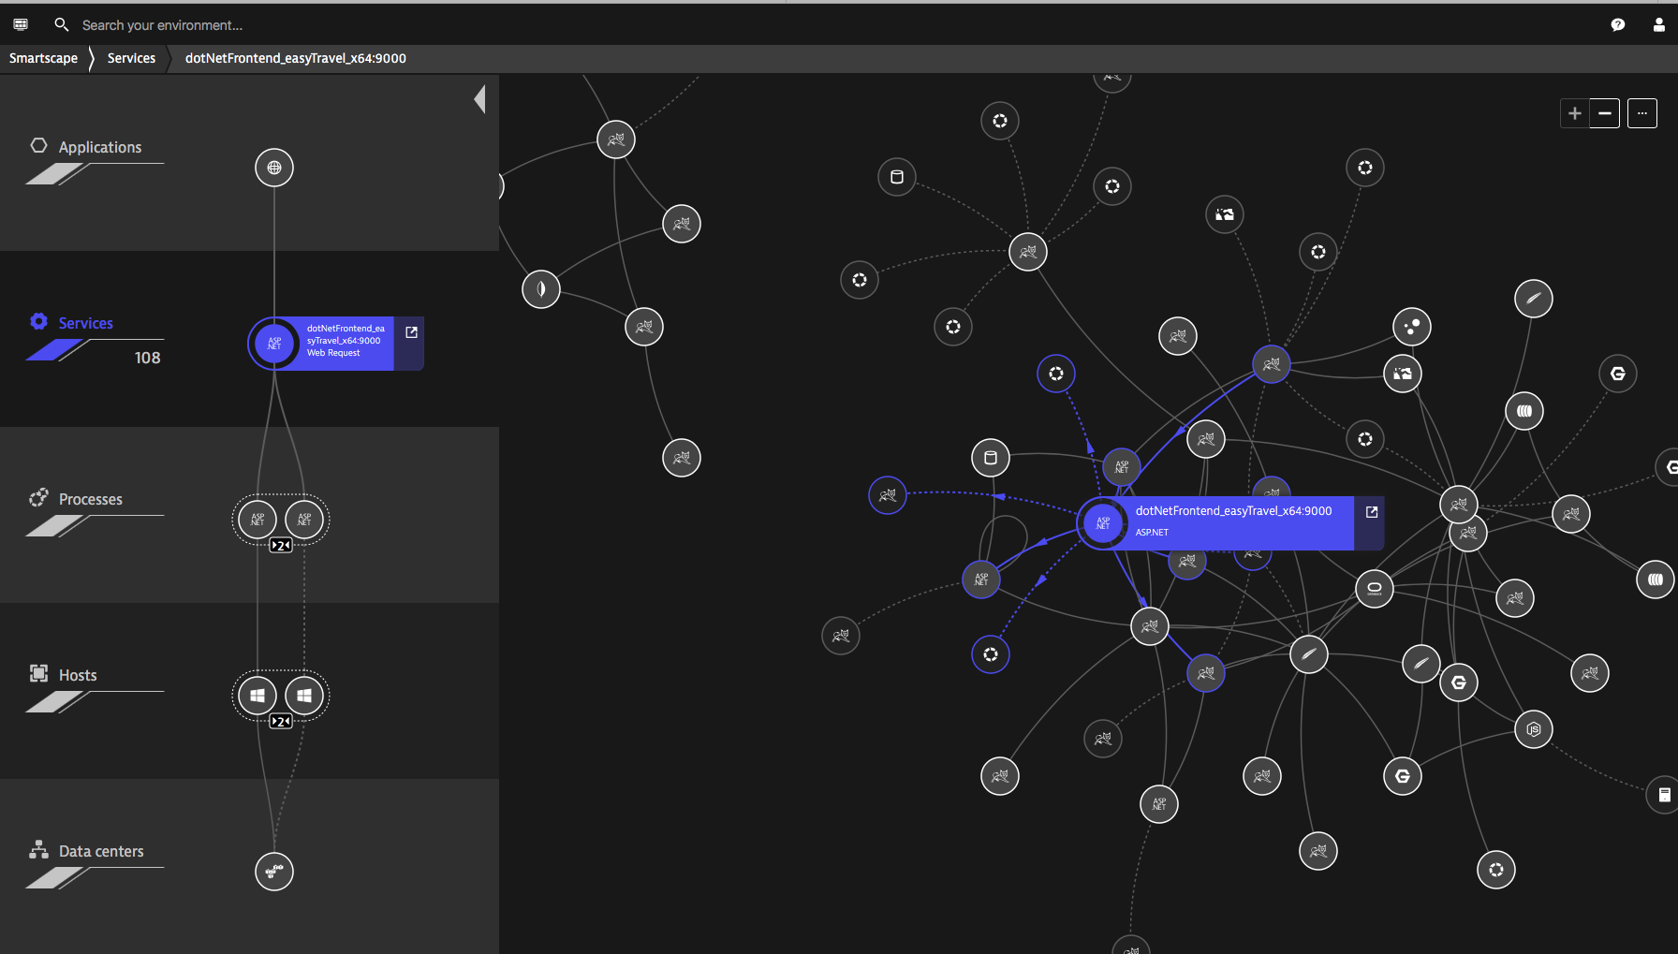
Dependencies between each entity
Across all your data centers

Slide 8
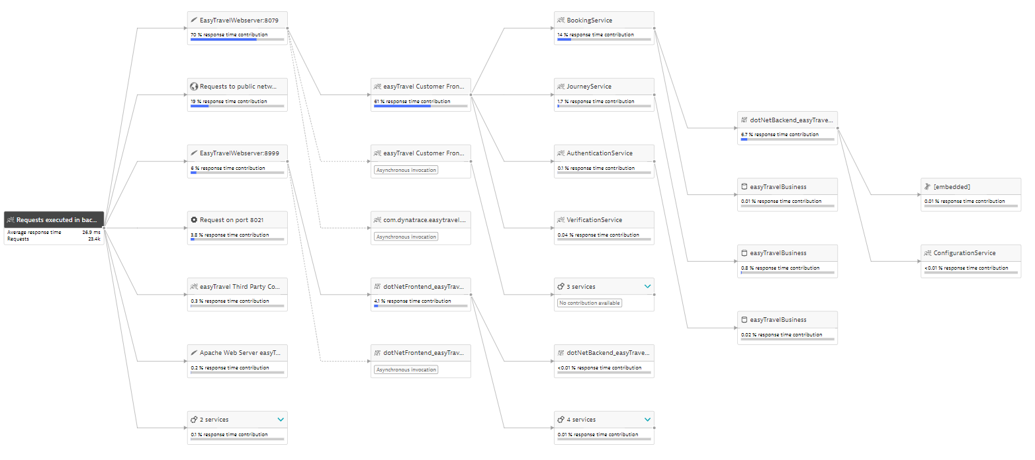
Automated End-to-End Tracing

Slide 9
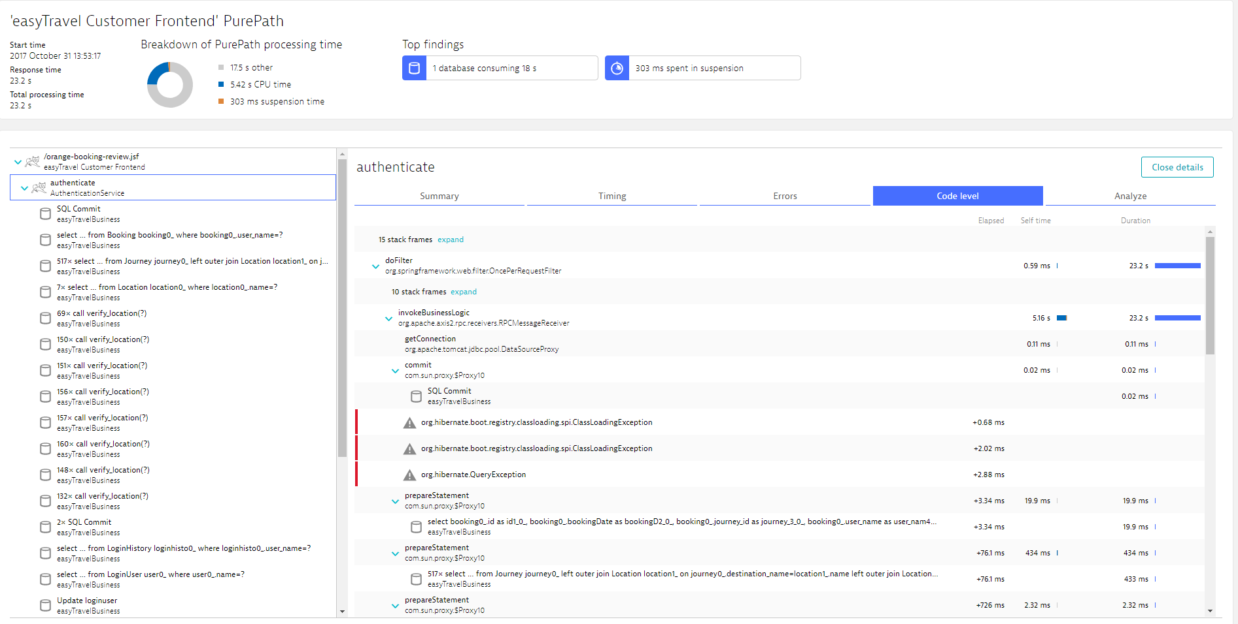
PurePath with Code-Level Details on each request

Slide 10
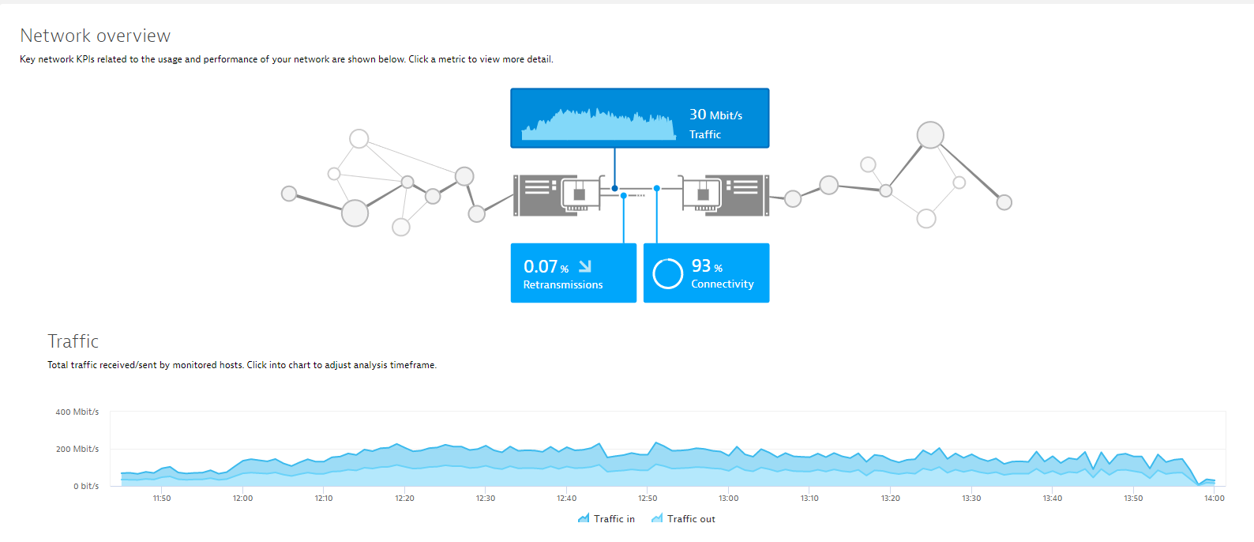
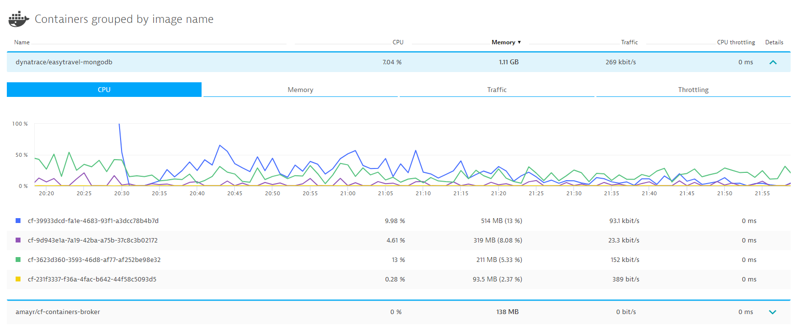
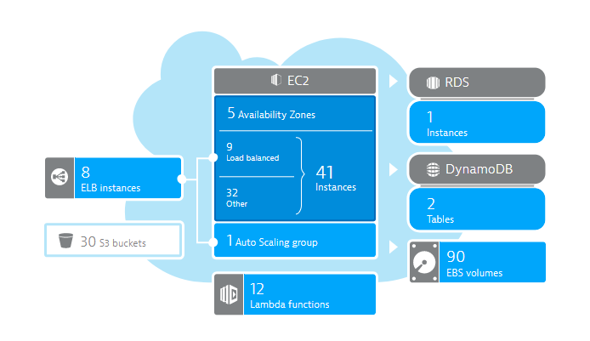
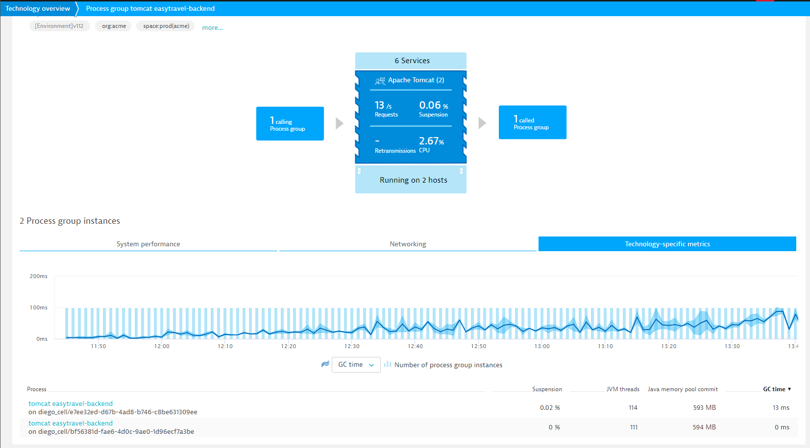
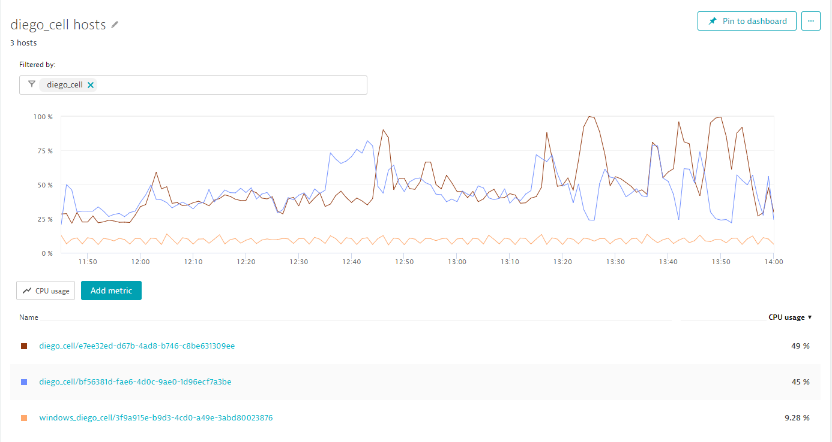
All Timeseries Data you can wish for ☺
Network
Container
Cloud
Servers
Hosts

Slide 11
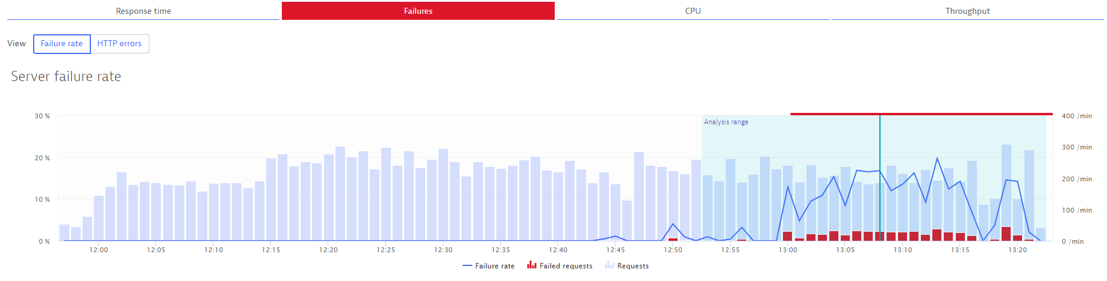
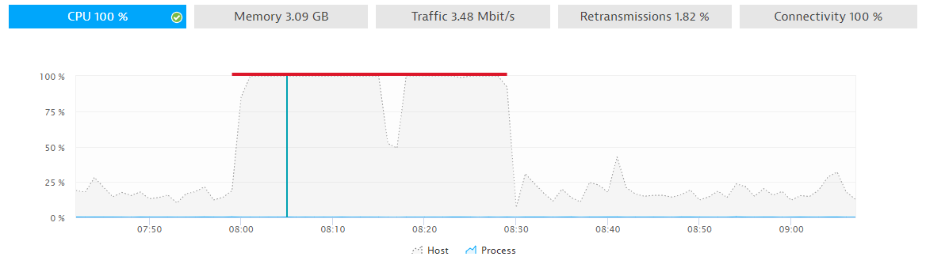
Everything automatically baselined!

Slide 12
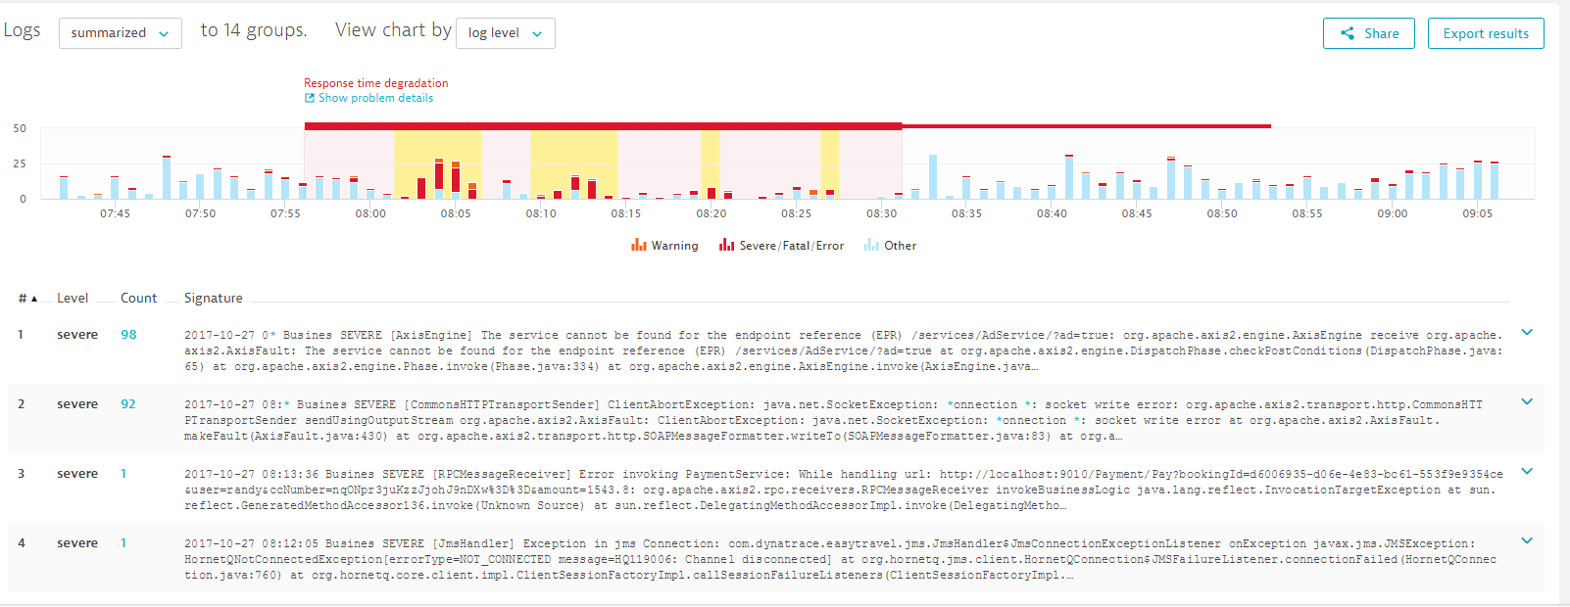
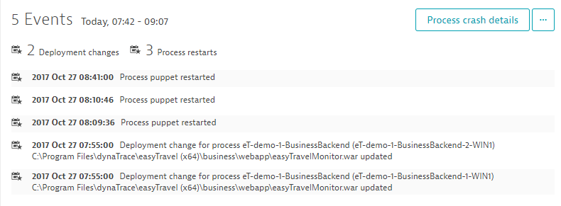
Automated Log Analytics and Change Detection

Slide 13
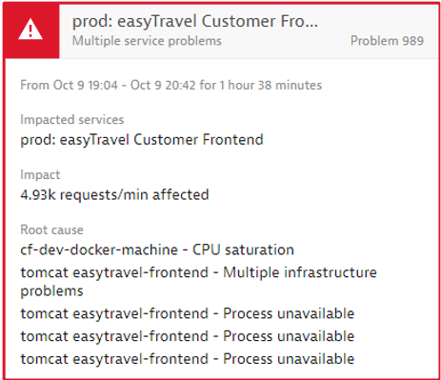
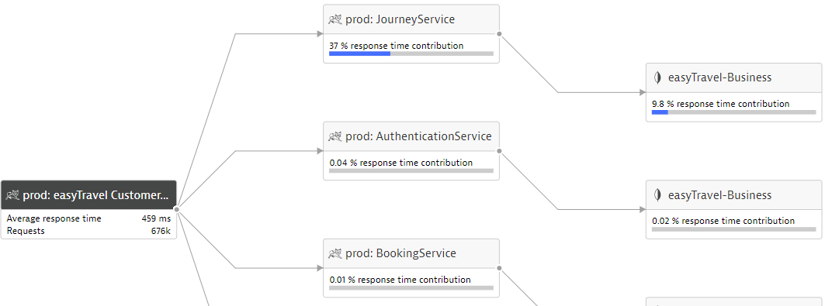


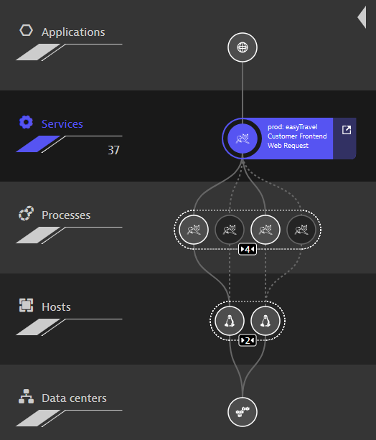
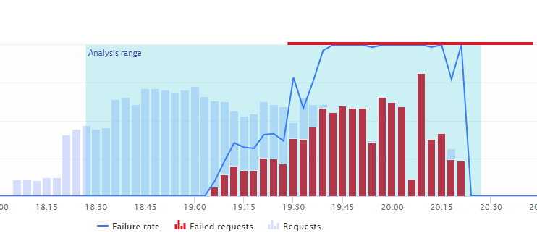
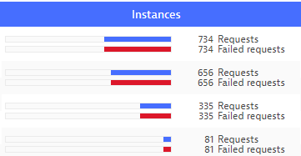
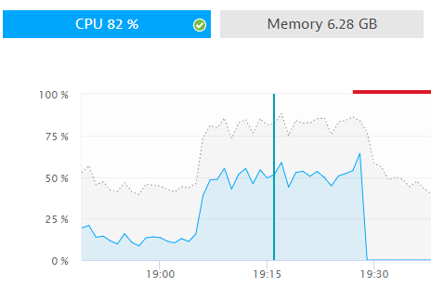
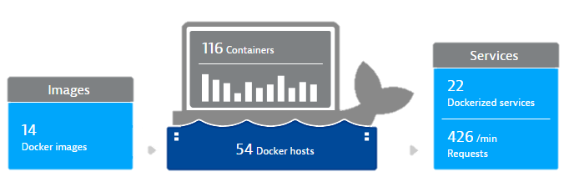

Your Users
Your Apps/Services
Dynatrace OneAgent
AI Supported Performance Engineering

Slide 14
Insights into the AI

Slide 15
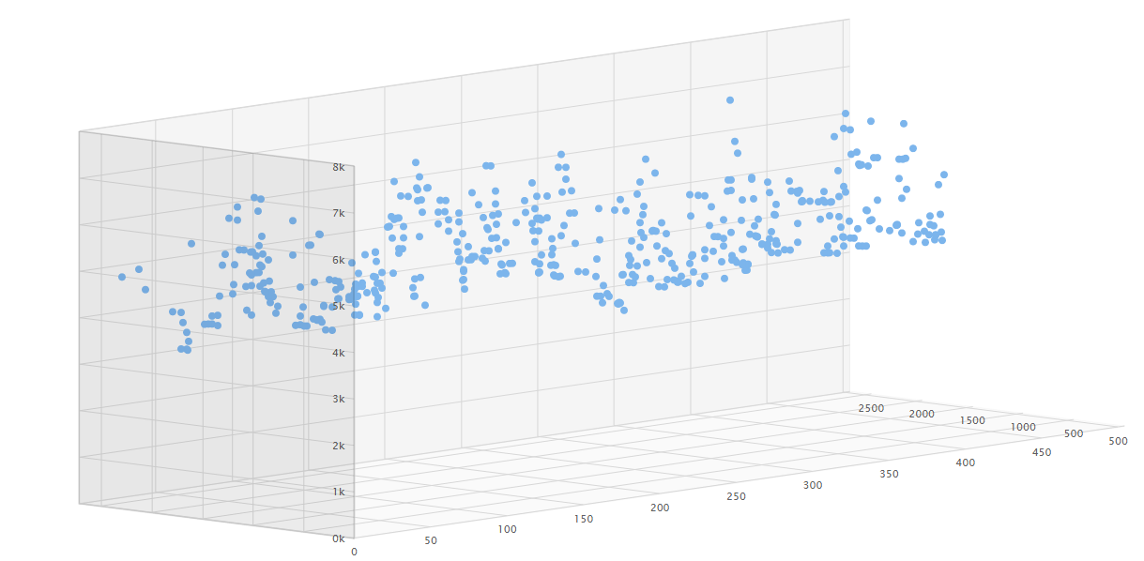
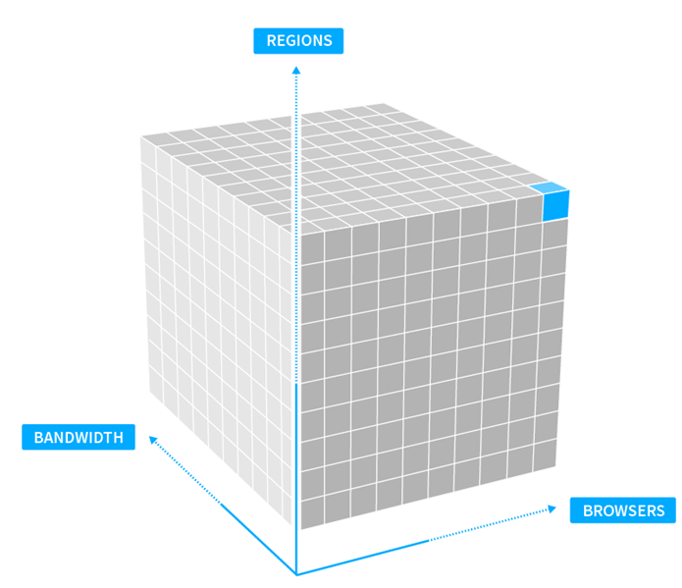
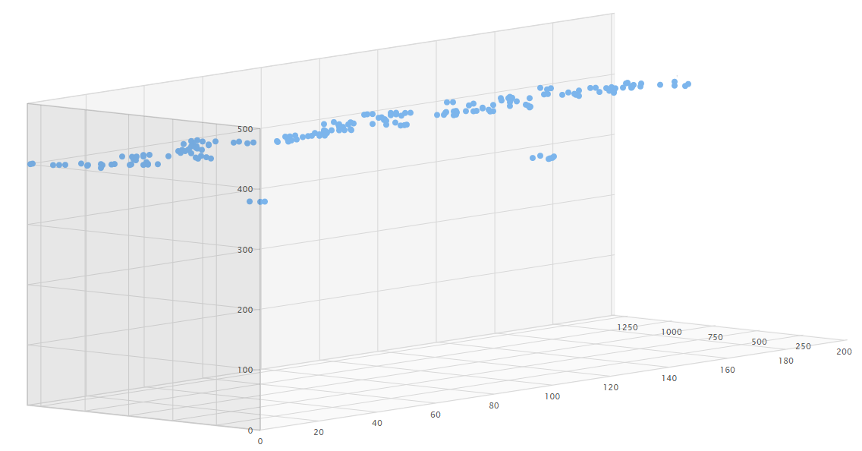
Smart anomaly detection (“Hypercube baselining”)
Automatic baselining (ON per default) - reliable (less false positives than competition)
due to
Special algorithms for different metrics
  Response time/load time/visually complete
  Error rate
  User load (availability)
Multidimensional baselining
New instances: no learning required!
Up to 10k cells per web/mobile app or backend service!
#13022
5 Dimensions
User action/ service method
Region
Browser
Operating system
Connection bandwidth

Slide 16
From events (incidents) to problems
Input: Notification sequence of
starting and ending events
Event correlation: Calculation of impact
relationships among all active events
Event 1
Event 2
Event 3
Event 4
Event 5
time
Causation: Rank events to identify
root cause within each group
Event grouping (Problems):
Identify events with same root cause
1
1
2
3
2

Slide 17
Some Slides removed from original presentation
because of confidential content

Slide 18
The Big Picture: Root cause ranking
Impact calculation only quantifies how individual events are related to each other
  But we need to evaluate the big picture to isolate the fault domain
Big picture: Graph analysis of resulting “impact graph” aka “Dynatrace Problem”
Vertices in problem graph ranked based on a custom Eigenvector Centrality algorithm
  Score of event depends on score of connected events and weights of respective incoming edges
  Root cause: Events that receive a distinguished score
„Problem“ 7
„Problem“ 23
0.1
C
E
0.5
0.2
A
0.7
0.3
F
D
B
Notes:
Eigencentrality: Weight of vertex (event) determined by weight of neighbor
Eigenvector centrality: Think of page rank
It assigns relative scores to all nodes in the network based on the concept that connections to high-scoring nodes contribute more to the score of the node in question than equal connections to low-scoring nodes.

Slide 19
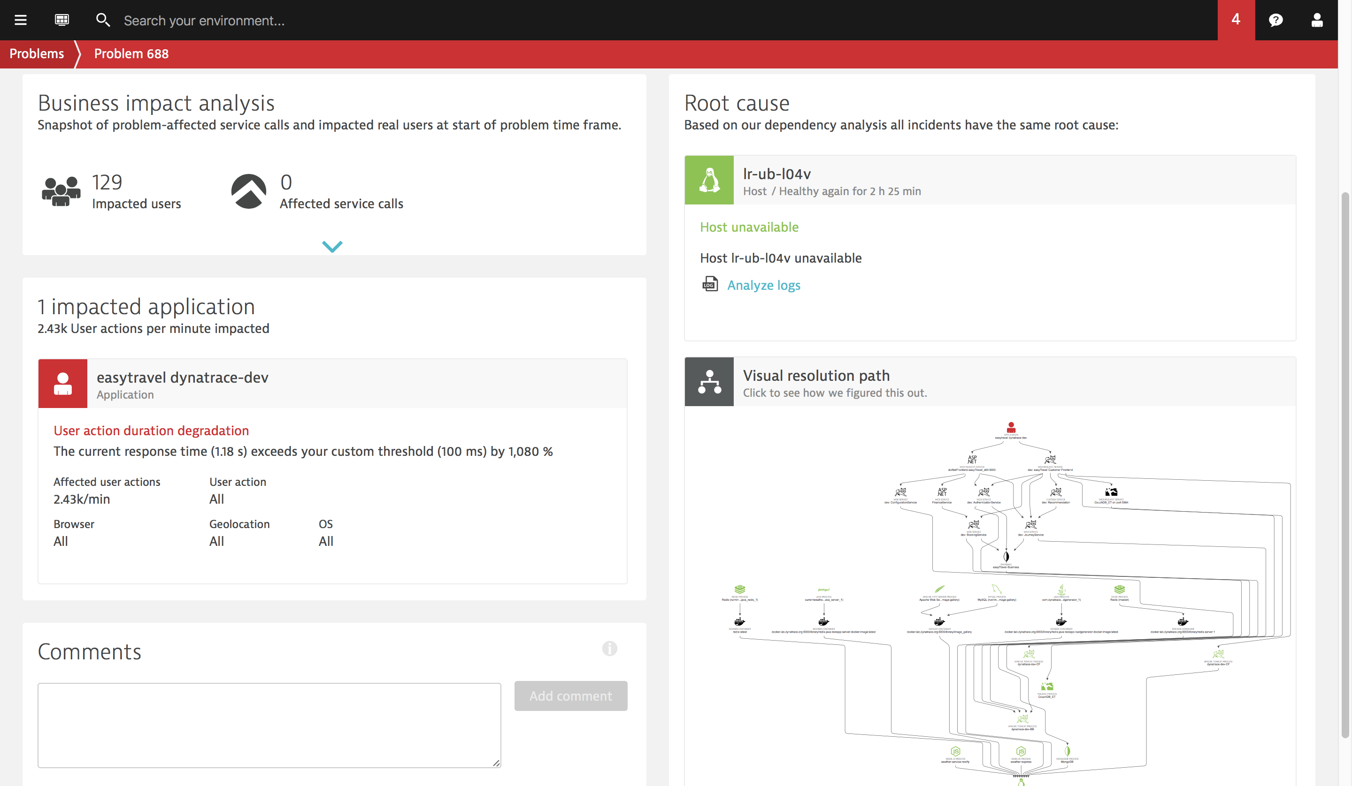
Notes:
Impact (measured and extrapolated!)

Slide 20
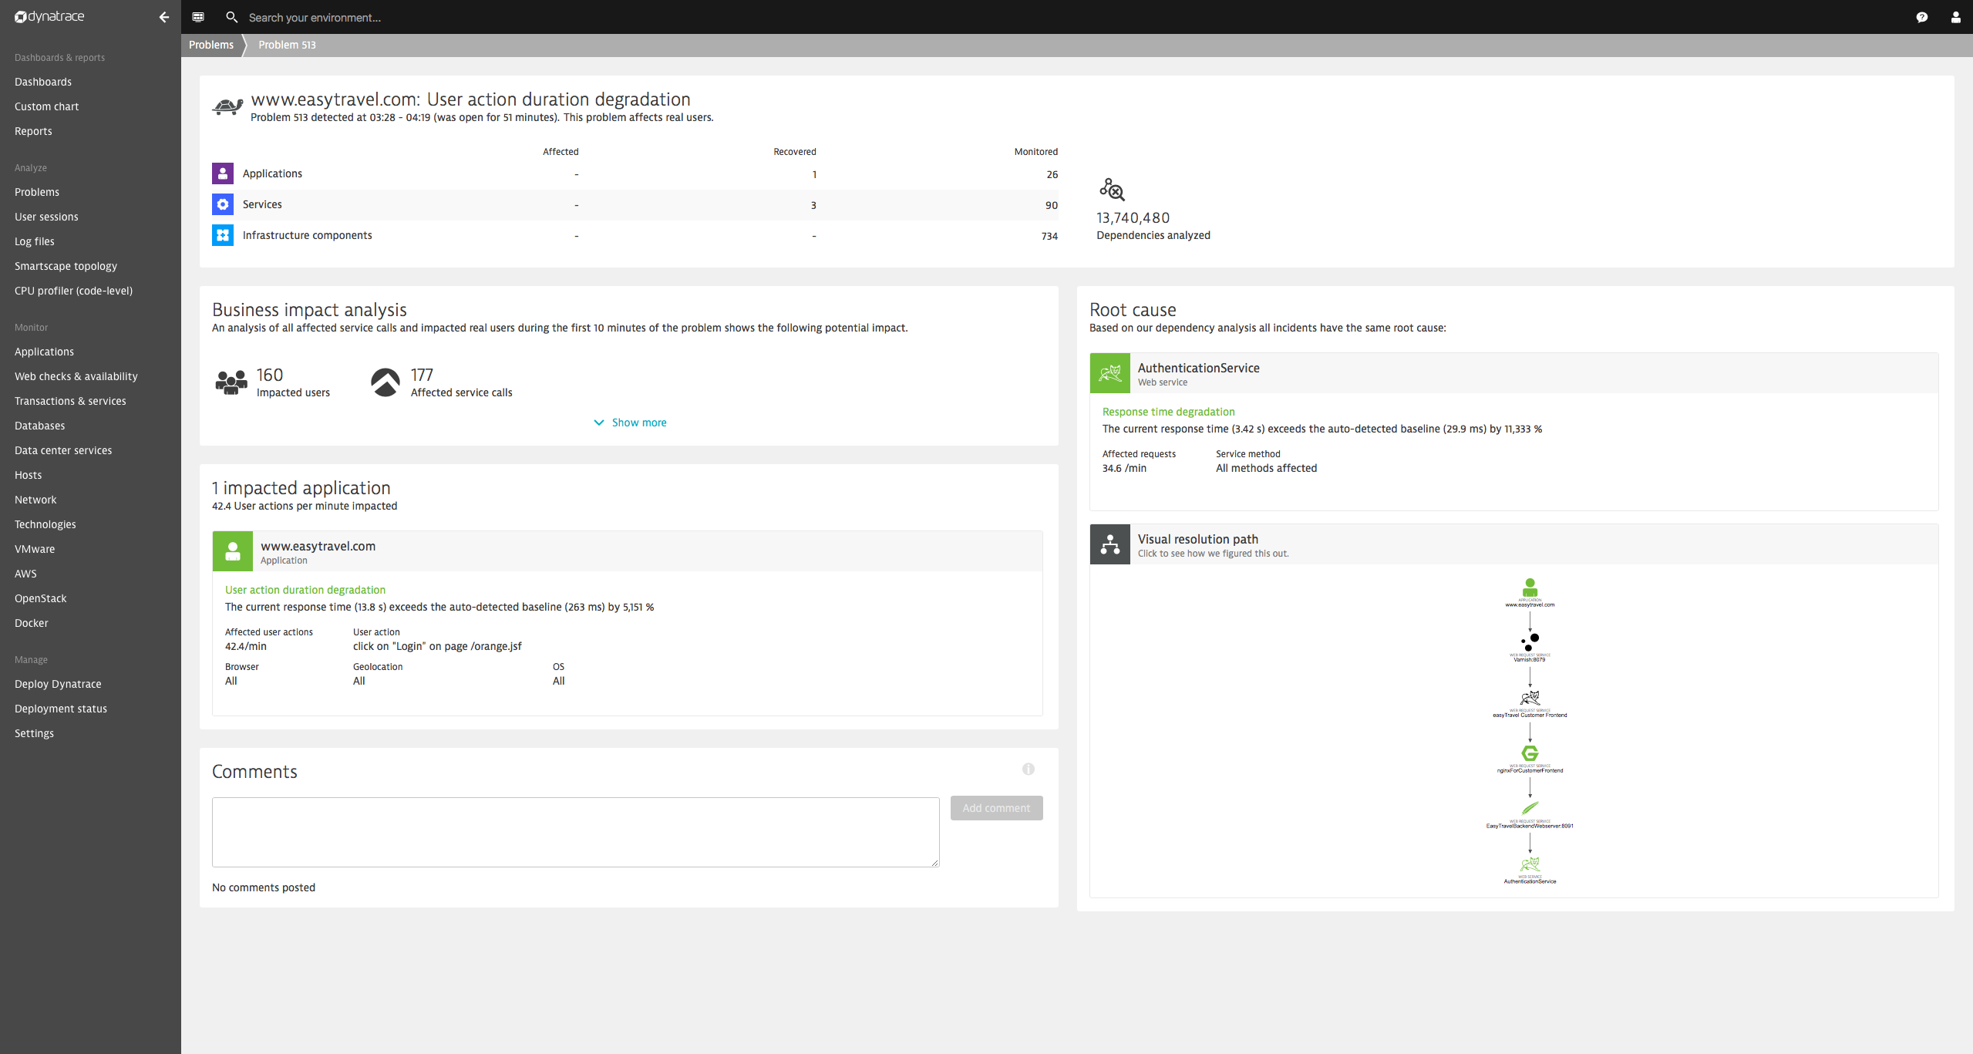
2 clicks!
Notes:
Impact (measured and extrapolated!)

Slide 21
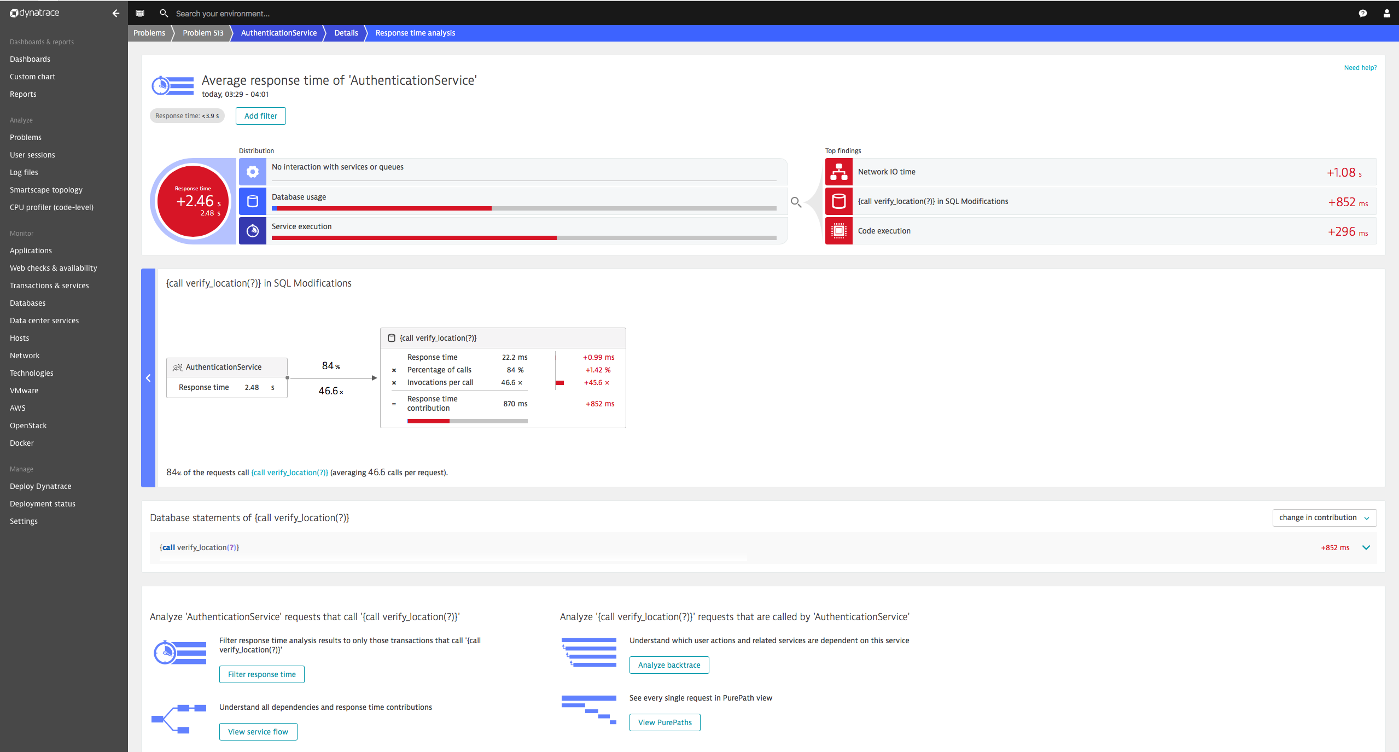
Notes:
Impact (measured and extrapolated!)

Slide 22
Dynatrace AI Demystified
Andreas Grabner, @grabnerandi

